Slide 1

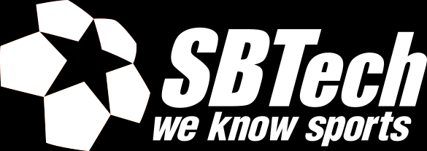
FRONT-END FOR LARGE SCALE APPLICATIONS
by Martin Chaov
Notes:
Hi, Everybody! Thank you for choosing us instead of the beach in this beautiful weather!

Slide 2
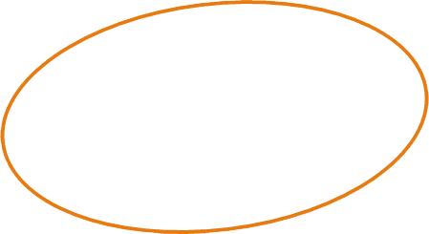
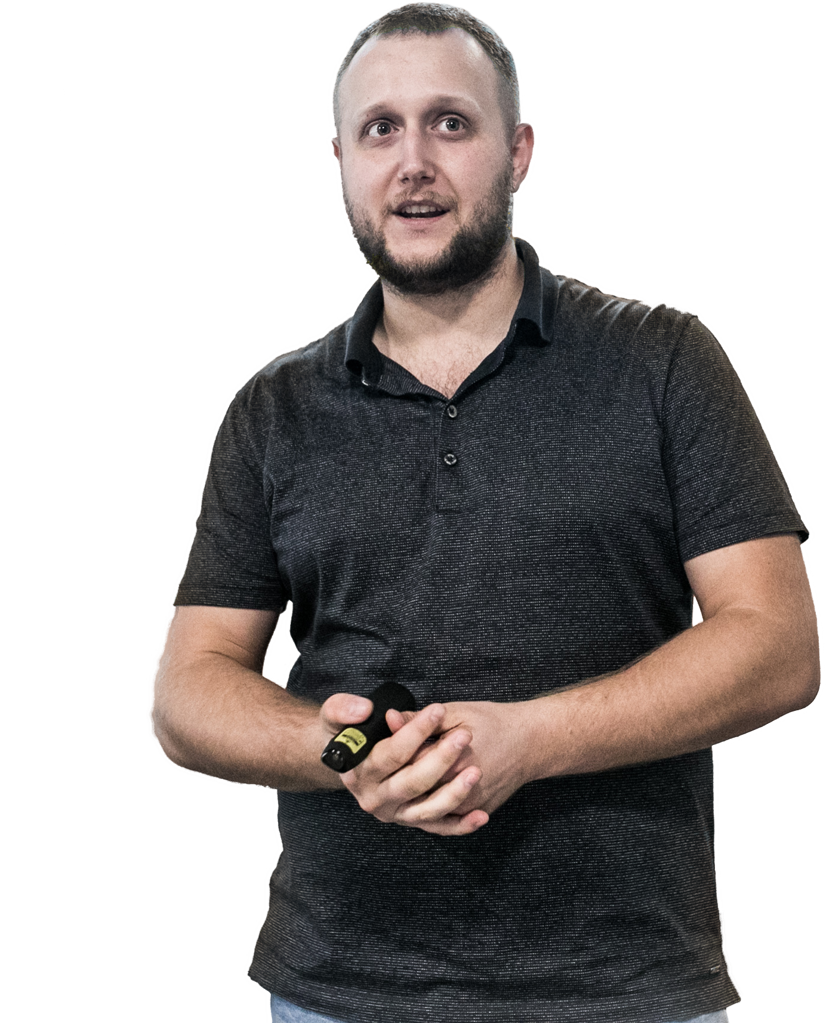
Hi, I’m Martin!
Tech enthusiast
Software architect
Ex-designer
Notes:
Well, I’m Martin ☺
I love technology, all kinds of it!
I don’t discriminate between front-end and back-end and am strong believer that all the software should have equal opportunity to be bad.
These days I work as software architect @ SBTech where we are developing a sports betting platform.

Slide 3

Notes:
Questions time!
Let me get to know my audience first.
Software engineers?
Back-end devs?
Front-end devs?
DevOps?
Feel free to interrupt me. If you don’t feel like it you will get another chance during the demo. I’d prefer to make a nice discussion out of this topic.

Slide 4
Topics
LSAs
Widgets
Platform for FE-LSAs
Demo
Notes:
I am going to start by discussing briefly what makes up an LSA
Then I have few slides that will describe our business case and are going to give you context on the presented approach.
Then I want to share with you architecture and platform for the development of large scale FE applications.
And if my PC works well by the end of the presentation I will make a demo of the presented approach.
(Open Sourcing)

Slide 5
What is a large scale application?
Performance
Scalability
Distributed architecture
Volume of data
Redundancy and availability
SOA
TDD, CD, CI
Team
Notes:
What makes an application large scale? Many buttons and color variations aren’t considered a merit for the definition of scale.
Performance
Being able to handle millions of concurrent users.
Tens and hundreds of thousands requests per second.
Fast loading times.
Scalability
Vertical and horizontal scalability.
Database flexibility: RDB, NoSQL.
Distributed architecture
Taking advantages cloud, CDNs and on premises solutions.
Volumes of data
Redundancy and availability
SOA – services oriented architecture
CD, CI
Team

Slide 6
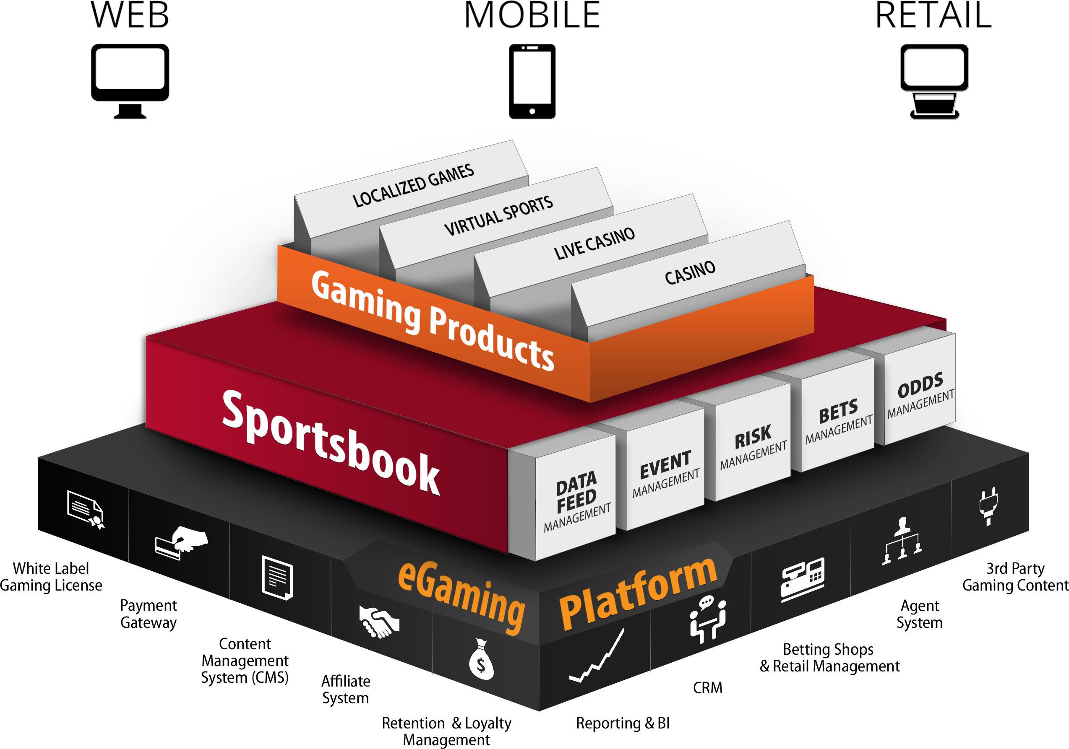
What are we dealing with?
60+ sports
2000+ betting markets
20 000+ live events per month
1500+ casino games
50+ payment methods
15+ regulated markets
20+ languages and currencies
RTL version in dev... ☺
Notes:
Alright context time ☺
Turn your attention to the amount of sports content.
20 000 live events per month, averages down to about 660 events per day!
Did you know that in lazy days there are between 30-50 live events around the globe?
Anyone here dealt with payment methods?
We cover over 50 of them in 15 regulated markets over 20+ languages and currencies...
Let me give you some insight onto what it means to work on regulated markets.
Polish taxes
Australian live betting
Since I mentioned localization, we are now investigating how to make our software RTL.

Slide 7
Notes:
Let me enlarge this beautiful graphic created by our designers.
All of the challenges we meet on:
Web and mobile devices
Custom hardware
Cross OS

Slide 8
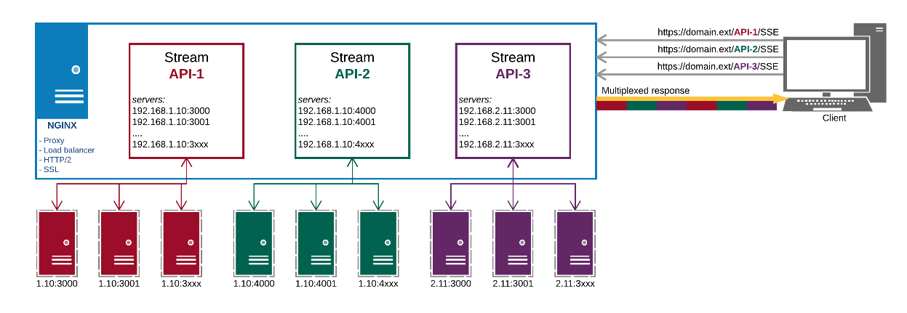
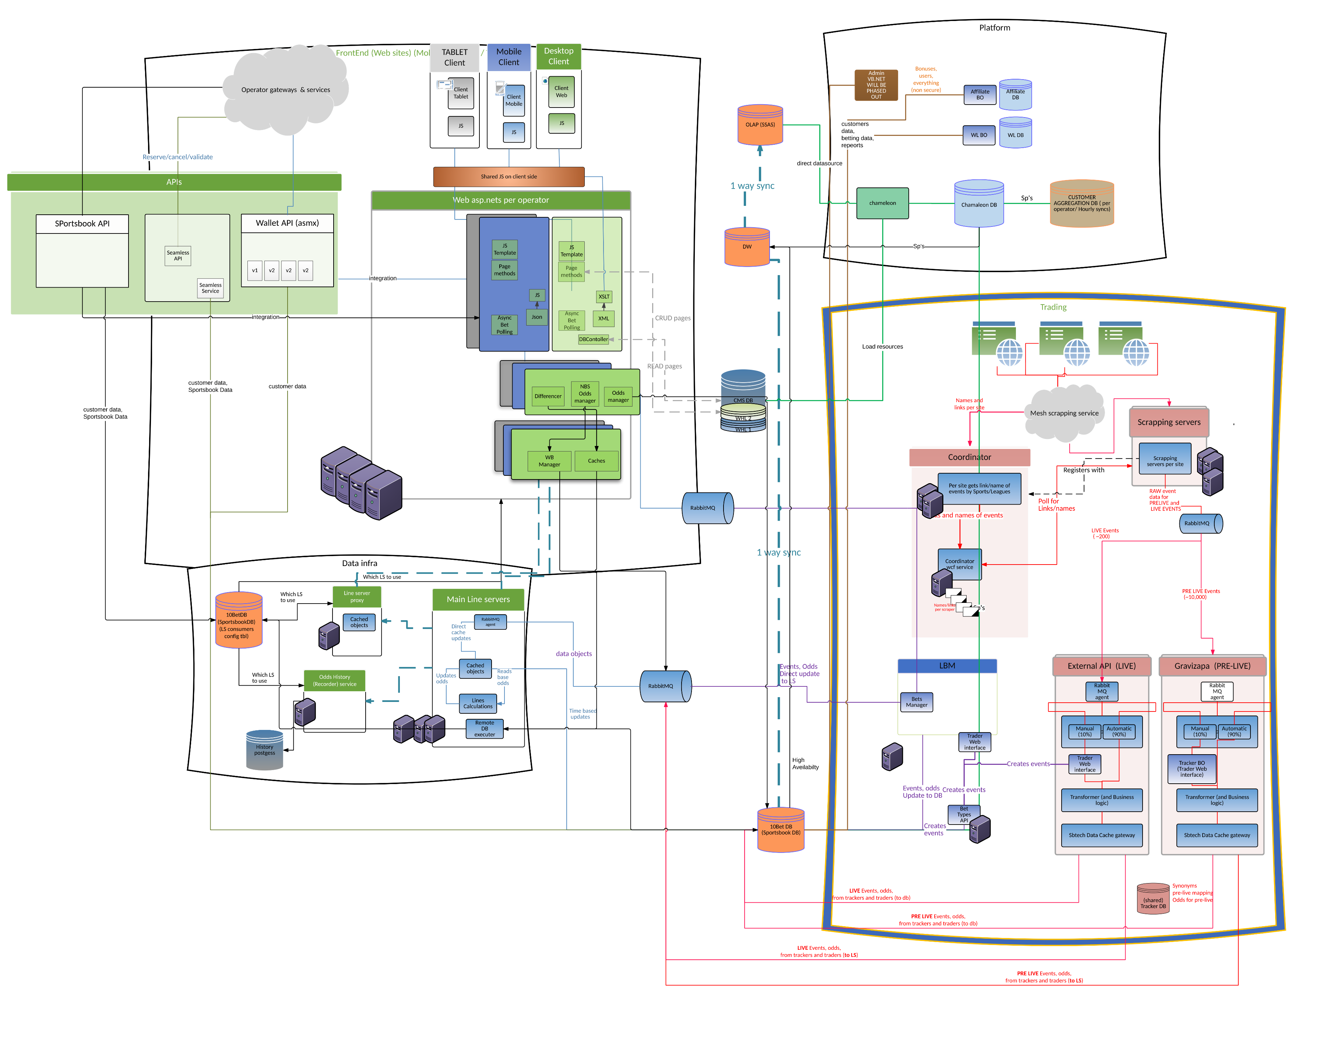
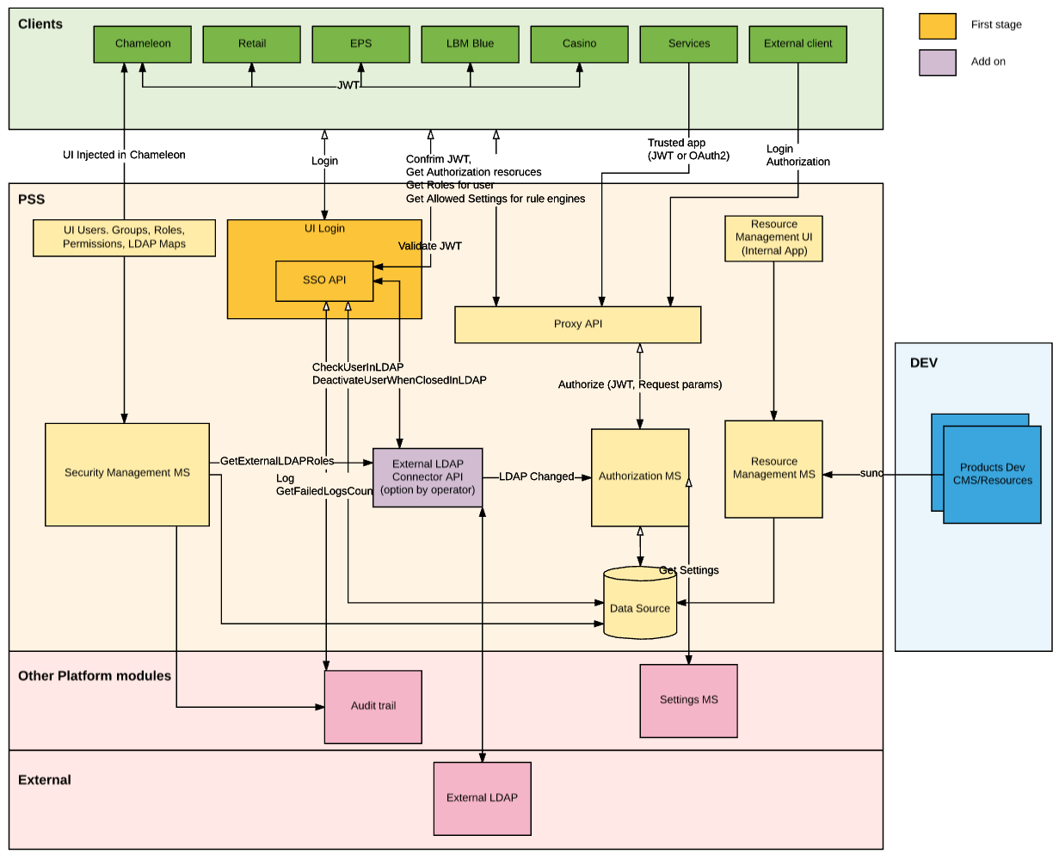
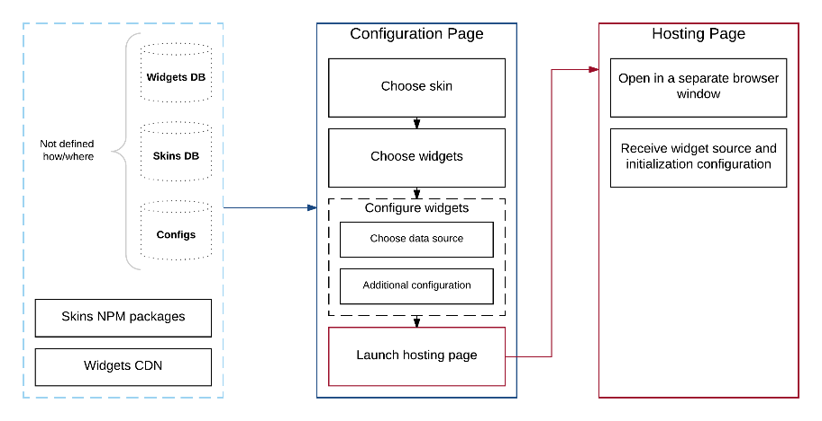
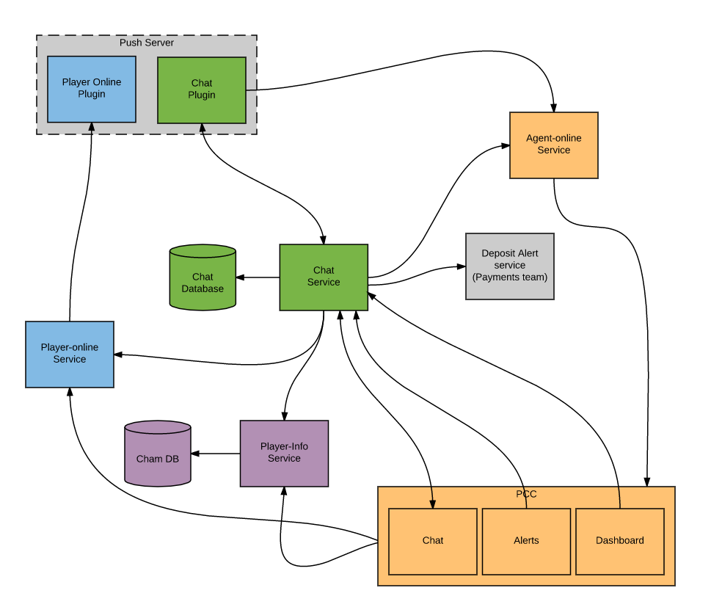
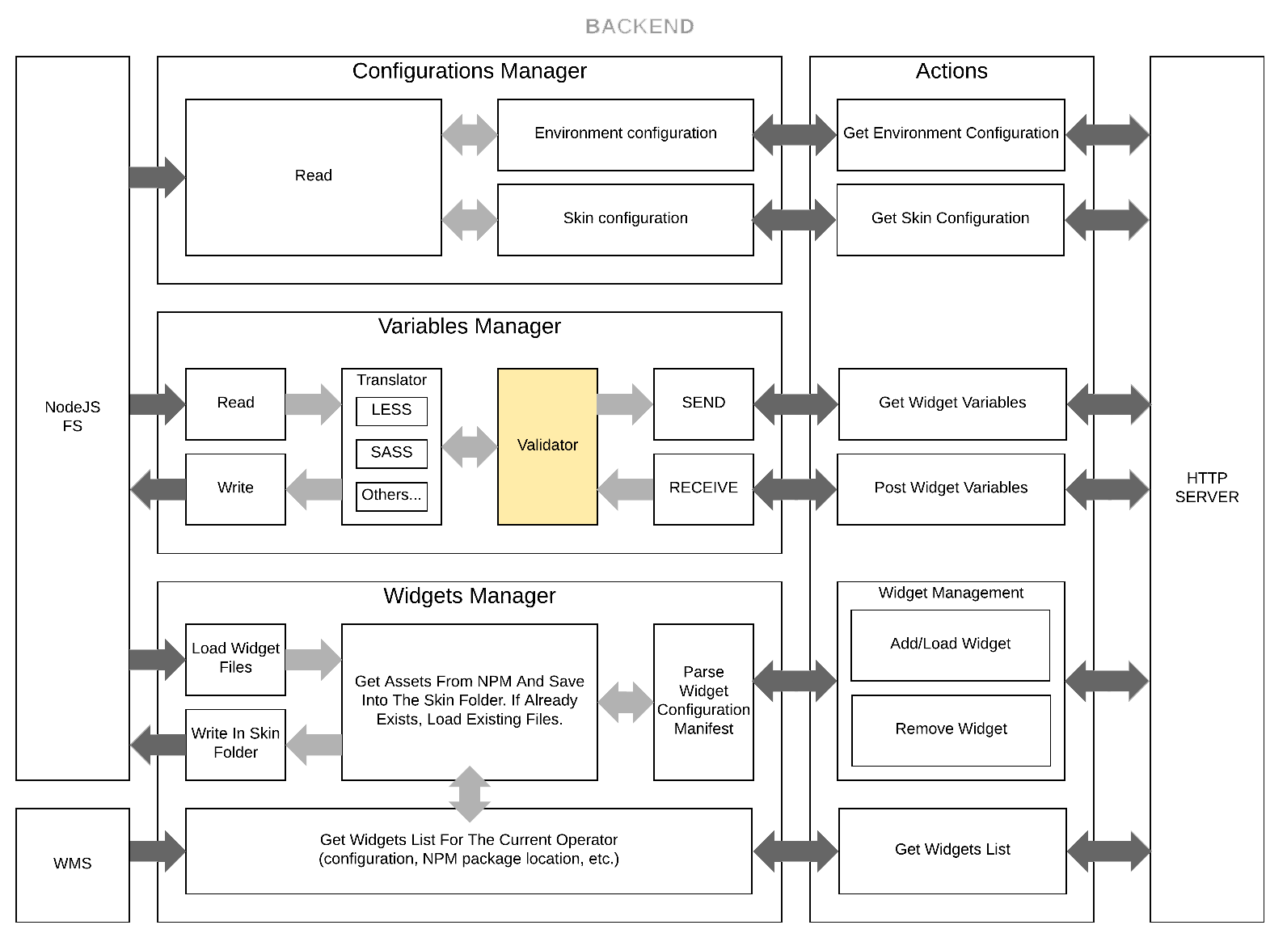
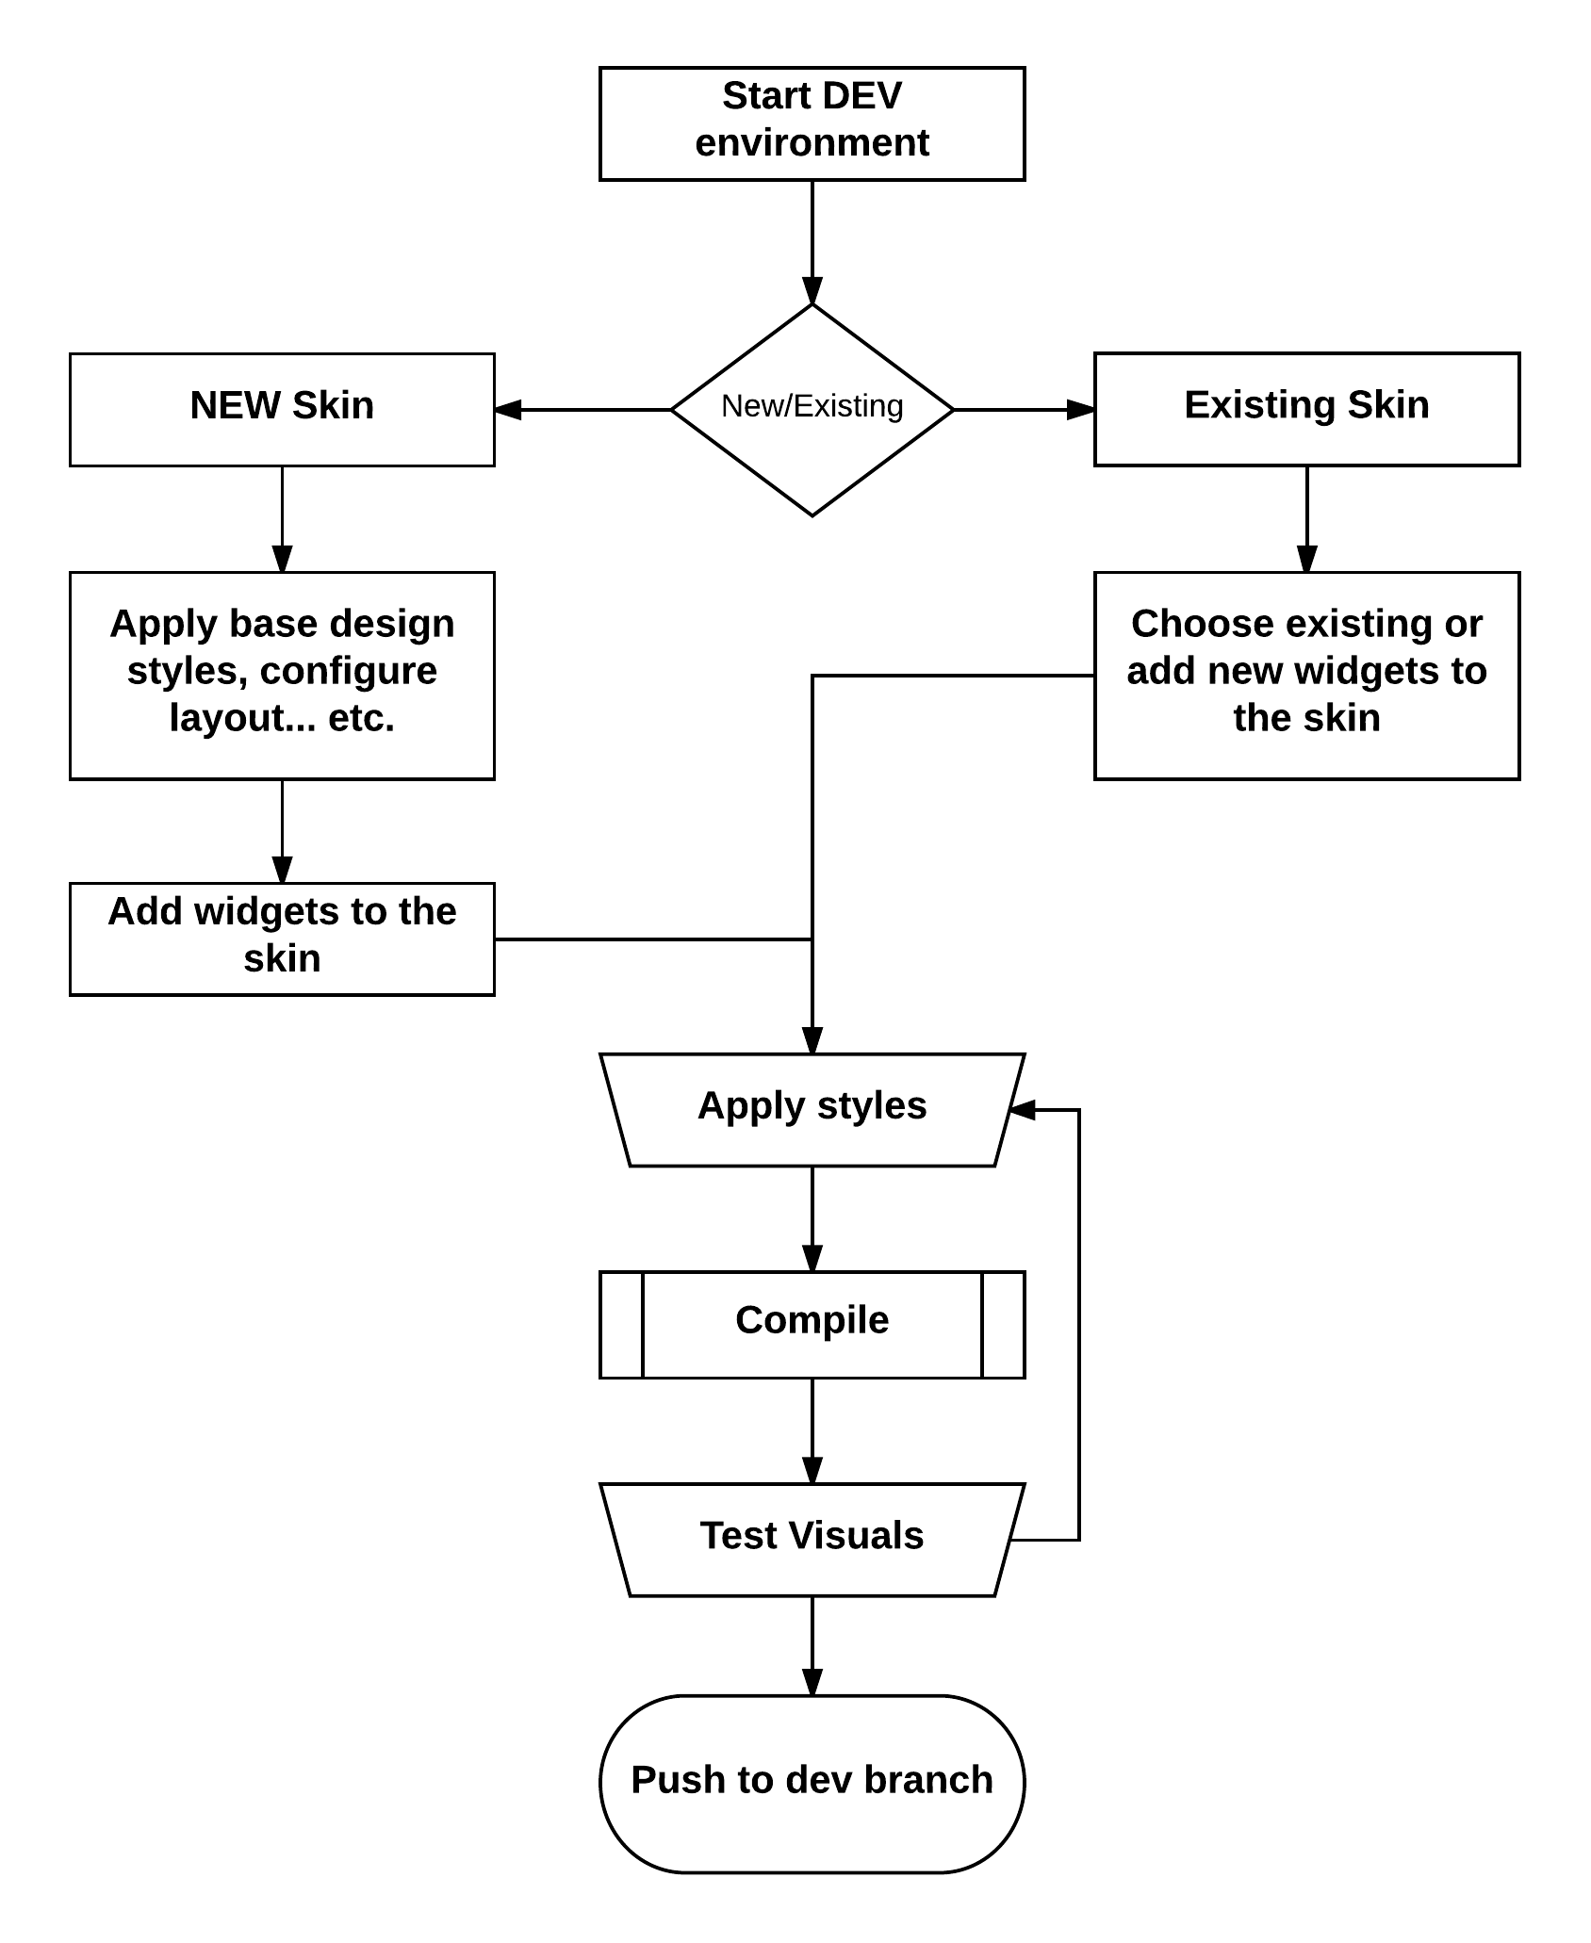
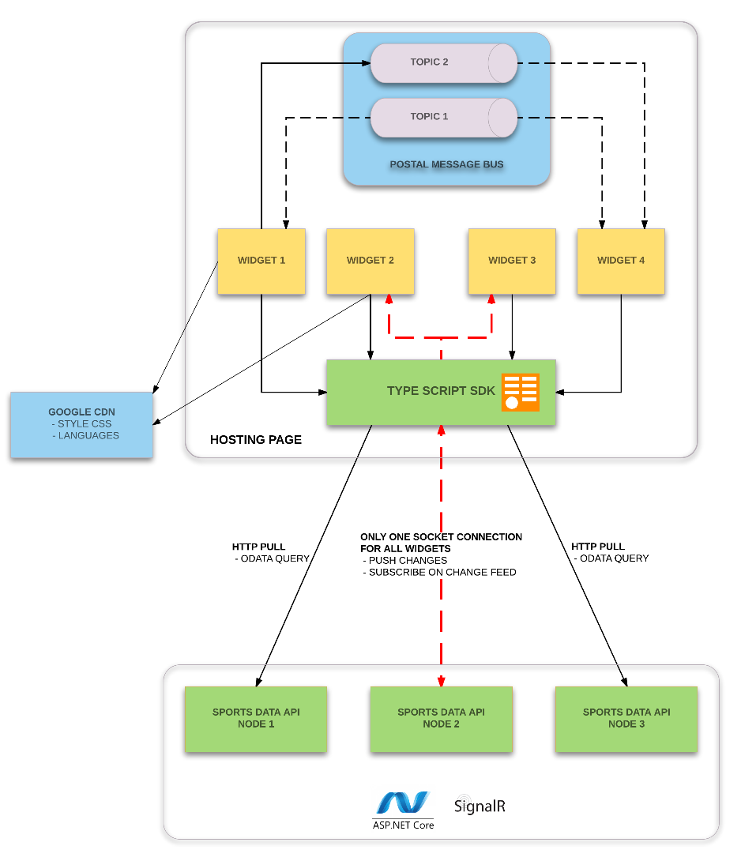
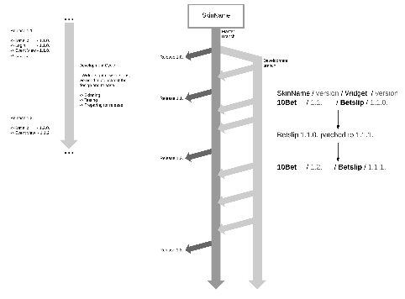
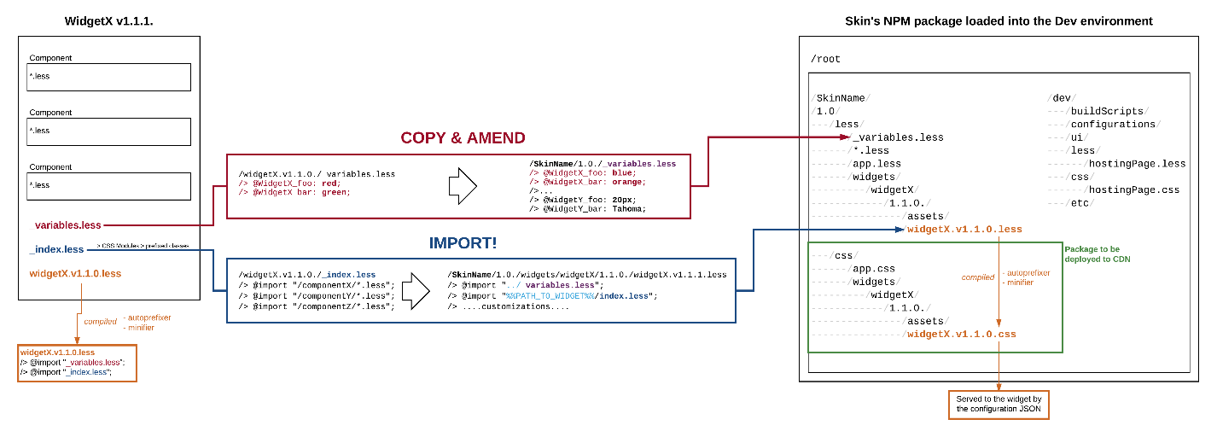
Notes:
On the back-end however we have this huge distributed architecture.
I know it’s not very readable at that zoom level, but can anyone guess where is the front-end located here?
// ---
Point FE
Point Widgets

Slide 9
So, what about the front-end?
Scalable code base
Performance oriented
Responsive
Decoupled from the back-end
Notes:
So what about the front-end?
It needs:
Scalable codebase
With the modern tech stack this is pretty much straight forward...
Performance oriented
Responsive
Decoupled from the backend

Slide 10
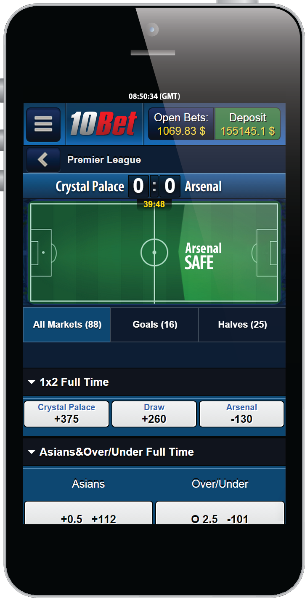
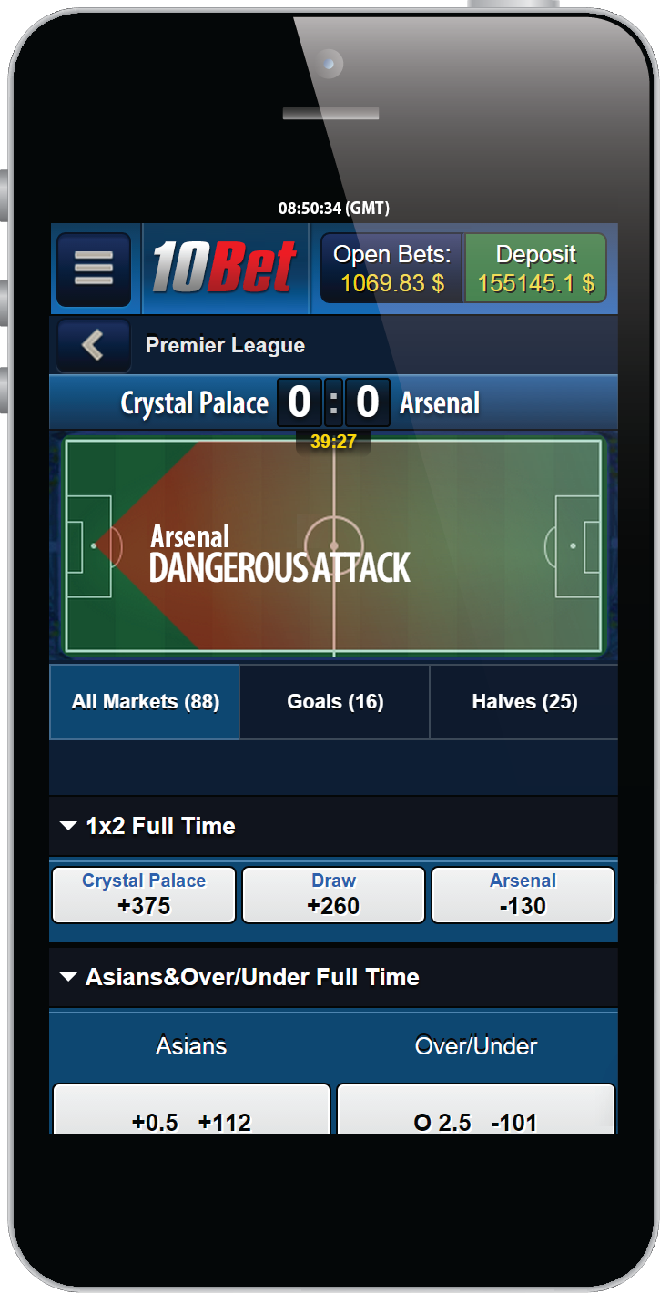
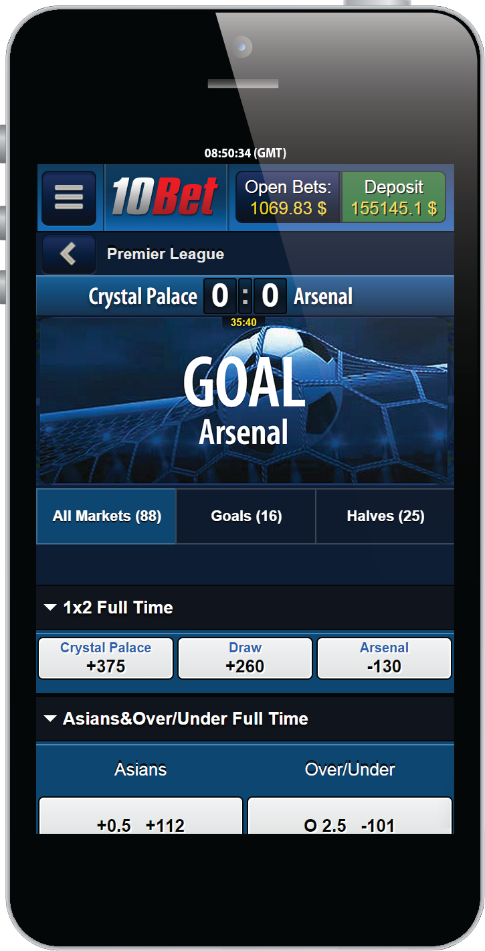
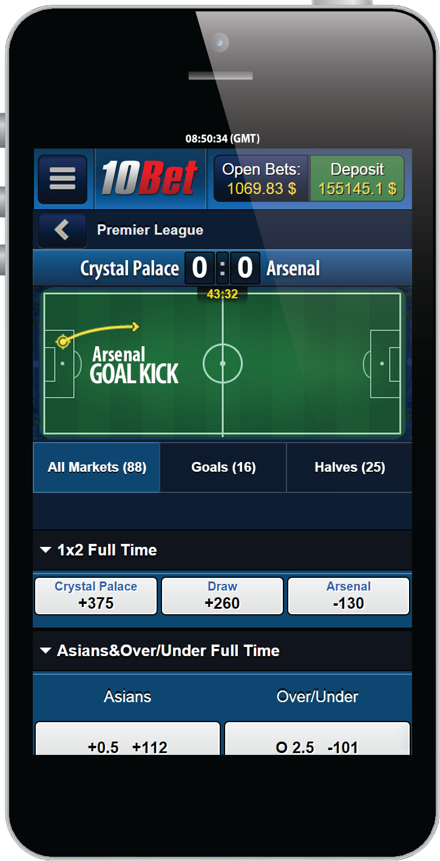
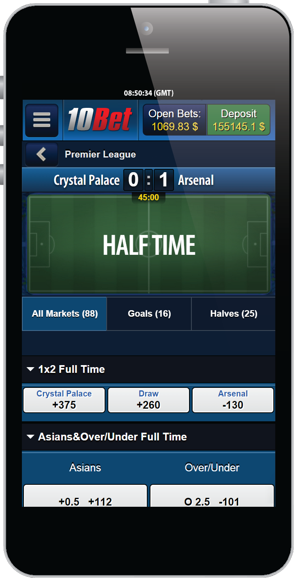
The widgets concept
Notes:
This is where we took the idea of widgets and applied few definitions...

Slide 11
What is a widget?
Stand alone and independent
Decoupled from other widgets
Decoupled from the back-end
Shares nothing!
Notes:
We define “a widget” as follows:
Stand alone piece of software, loads whatever it needs to run
It is decoupled from other widgets and doesn’t know about their existence
Decoupled from the backend
Share nothing, not even a single image

Slide 12
Widgets project
Project
Dependencies
Widget
Component
Services
Component
Services
Widget
Component
Services
Component
Notes:
In order to develop a widget we need to define “some platform” that is going to aid us in the process.
This platform will give us:
Scaffolding
File structure
Testing framework
And so on...
We want this to be streamlined and repeated per project so we need to abstract it...

Slide 13
Platform
Widgets project
Project
Dependencies
Widget
Component
Services
Component
Services
Scripts
Component
Widget
Services
Component
Notes:
I will explain these in details in a few slides, but first:

Slide 14









Tech stack?
...and more...
Notes:
What about the tech stack?
There is quite the variety to choose from...
We want to be in a place where we can exchange one tool with another without re-writing everything...
// - Tell on why we didn’t choose angular...

Slide 15


Platform tech stack
Notes:
On the platform level we need only the tools that are going to be used across all widgets...
We use:
Typescript
Lodash
Mobix
React
Postal
Polyglot.js
Window.fetch polyfill
These cover the most part of our platform requirements as they. However we can add additional packages dependencies if needed on the widget project level.

Slide 16




Dev tools
Notes:
Development tools
Webpack, Yarn and Gulp for building
Jest and Enzyme (no browser needed) for testing
TsLint
JSCPD
LESS

Slide 17

Package management
depcheck
Notes:
By now we’ve generated significant amount of packages and we need to manage them...
In short nothing on the market was giving us exactly what we need so we developed our own based on ideas from KnitJS and Depcheck.
knit.js – small, smart library for managing multiple packages and includes version managing. All dependencies for all packages stored in one place and package.json for each package generated during the publishing. Main cons of knit.js this tools do not support typescript projects
Depcheck can analyse code and give us list of dependencies for the peace of code, we take the list and get all dependencies from the single place and generate package.json with the list before publishing the package to NPM.

Slide 18


Automated testing
Notes:
For automated testing we chose:
webdriver.io -> wrapper over webdriver for node.js
Cucumber.js -> BDD framework, Gerkin scenarios

Slide 19
Platform
TypeScript
React
MobX
Etc.
Widgets project
Project
Dependencies
Widget
Component
Services
Component
Services
Scripts
Build
Test
Lint
Deploy
Component
Widget
Services
Component
Notes:
Basic development flow

Slide 20
Widgets project
Compiled Widget
Project
Dependencies
Widget
Component
Services
Component
Component
Component
Services
Widget
Component
Services
Services
Component
Project
Dependencies
Notes:
Compilation of widget

Slide 21
HOSTING PAGE
WIDGET 1
WIDGET 2
WIDGET 3
WIDGET 4
CDN
API node
API node
API node
Notes:
Hosting page
Using widgets on production

Slide 22
Platform.addWidget(
"widget-event-view",
"fb9c4fb6-a6a6-4b85-86e5-1da0f0b96022",
{
"widget-event-view": {
"props": { CONFIGURATION }
}
}
);
Notes:
Adding widgets to the page

Slide 23
HOSTING PAGE
WIDGET 1
WIDGET 2
WIDGET 3
WIDGET 4
CDN
API node
API node
API node
Notes:
Now we have widgets loaded that can’t talk to each other ☺

Slide 24
HOSTING PAGE
Message bus
WIDGET 1
WIDGET 2
WIDGET 3
WIDGET 4
CDN
API node
API node
API node
Notes:
Widgets communication

Slide 25
HOSTING PAGE
Message bus
Topic 1
Topic 2
WIDGET 1
WIDGET 2
WIDGET 3
WIDGET 4
CDN
API node
API node
API node
Notes:
Mbus
-> Getting data from the back-end?

Slide 26
HOSTING PAGE
Message bus
Topic 1
Topic 2
WIDGET 1
WIDGET 2
WIDGET 3
WIDGET 4
TypeScript SDK
CDN
API node
API node
API node
Notes:
Getting data from the back-end

Slide 27

WAIT

Slide 28
Something is missing
Notes:
Did you guys notice what’s missing so far?
Which is the hardest part of the front-end to scale?

Slide 29
What about the design?

Slide 30
How do you scale the design?

Slide 31


Slide 32
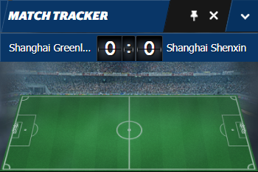
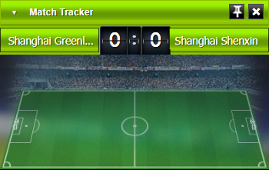
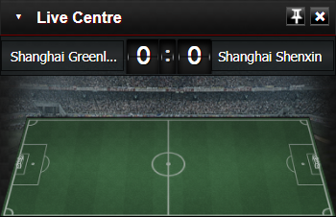
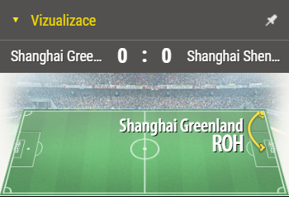
A step back
Widgets have design... duh
Design language is shared in an application
Notes:
Quick step back.
Widgets have designs... However widgets share nothing, but the design language is shared inside the same application (comprised of many widgets).
So how do we make the design scale?
Any ideas?

Slide 33
Design is compiled
Pre-processors
CSS Modules
BEM
Default colors palette
Notes:
To compile the design we need another set of tools:
Pre-processors
Post CSS
CSS Modules
BEM
Default color palette

Slide 34
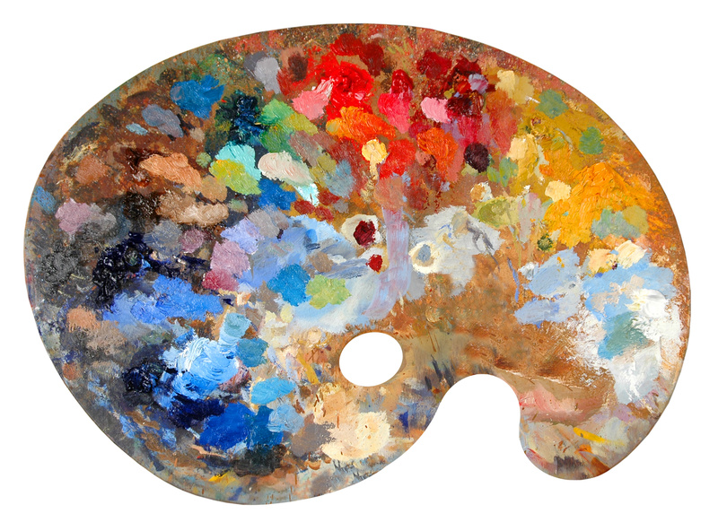
A palette?
Notes:
A palette?
Widgets are developed according to a base color palette that gives colors/fonts variables names.
Then we compile the widgets with different palettes.
This is how this works:

Slide 35
Widgets project
Compiled Widget
Project
Dependencies
Widget
Component
Services
Component
DESIGN.LESS
Component
Component
Services
Widget
Component
Services
DEFAULT PALETTE
@primaryText: #000
@primaryBg: #FFF
@accent: #C70000
DESIGN.LESS
Services
Component
Project
Dependencies
DESIGN.LESS
Notes:
Default values names used in the presentation are embedded into them during the compilation time.

Slide 36
Widgets project
DESIGN.LESS
Compiled Widget
Widget
Component
Services
DESIGN.LESS
Project
Dependencies
Component
Component
DESIGN.LESS
Component
Services
Widget
Component
Services
DEFAULT PALETTE
@primaryText: #000
@primaryBg: #FFF
@accent: #C70000
Services
Component
Project
Dependencies

Slide 37
Customized Design
Palette
Widget
Customized Design
Palette
Palette
Customized Design
Notes:
Then widgets are compiled with different palettes.

Slide 38
WIDGET
Notes:
On production we have only one JS bundle for every widget.

Slide 39
Client X
Client Y
Client Z
WIDGET

Slide 40
Client X
Client Y
Client Z
WIDGET
CDN
CDN
CDN

Slide 41
Platform.addWidget(
"widget-event-view",
"fb9c4fb6-a6a6-4b85-86e5-1da0f0b96022",
{
"widget-event-view": {
"props": { ... ... ... }
}
},
{
skinRootUrl: "http://URL.TO/desing.css"
}
);
Notes:
URL to the compiled per widget design is passed in the configuration of the widgets.

Slide 42
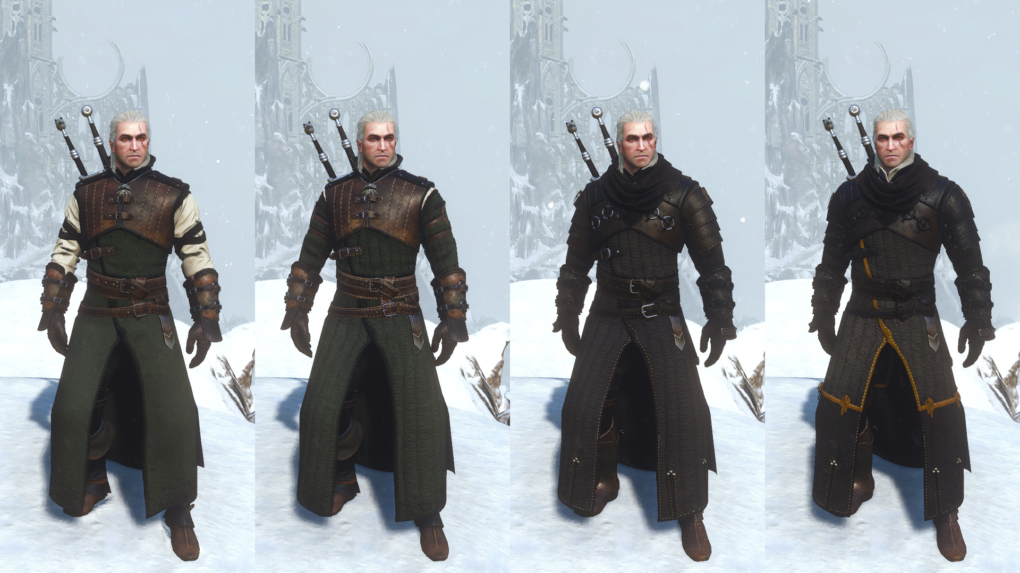
Geralt
APPROVES

Slide 43
But what if it’s more than just color changes?

Slide 44
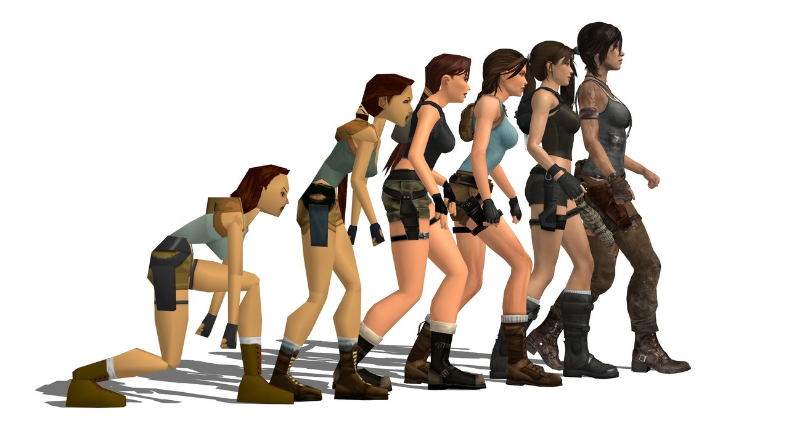
Version Evolution

Slide 45
|:}{:[ ~ What about a DEMO? ~ ]:}{:|

Slide 46


Slide 47


Slide 48

Connect ☺
LinkedIn: https://goo.gl/CRRJ2Y
Mail: martin.c@sbtech.com
Github: https://github.com/mchaov

